Slide 1
Trường TH & THCS Xanh Tuệ Đức Nghệ An
Vinh University
Speech is not Enough!
Kent Wallace

Slide 2
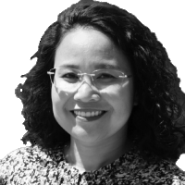
“Why is it that Vietnamese learners who achieve band 7.0 or 8.0 in IELTS are still unable to share their knowledge or use English to prove, analyze, explain, or criticize any topic at the expected level?”
November 26, 2022 | 06:38 am GMT+7
Chu Thi Van Anh
Education expert
- Chu Thi Van Anh

Slide 3
Triangle method
Communication (Speaking)
Expressive
Reading
Writing
Loud
Clear

Slide 4
Revise the ABCs

Slide 5
Blackpink

Slide 7
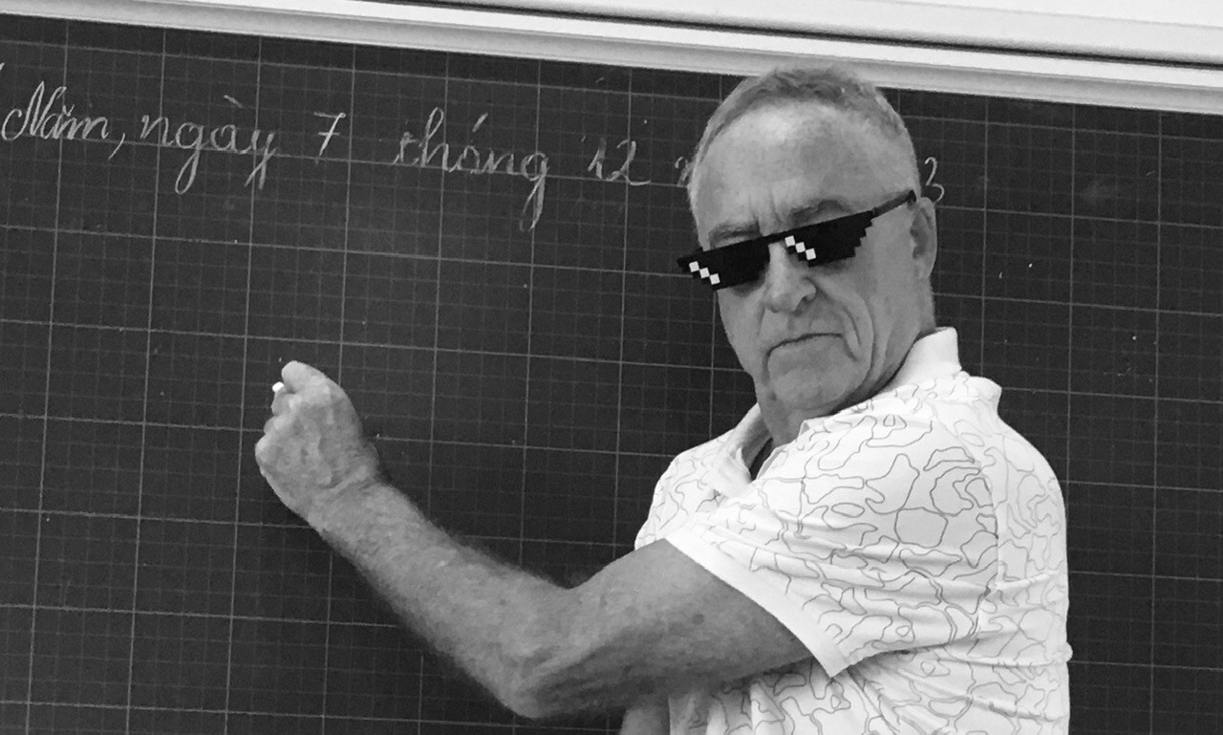
Speech is not enough!

