Slide 1
Mediation in Meaning Changes: The Case of “Border” as “Barrier” & “Connectivity”
VNU – ULIS’ Project N. 24.12
Chu Thanh Vân, H.N.T. Trang

Slide 2
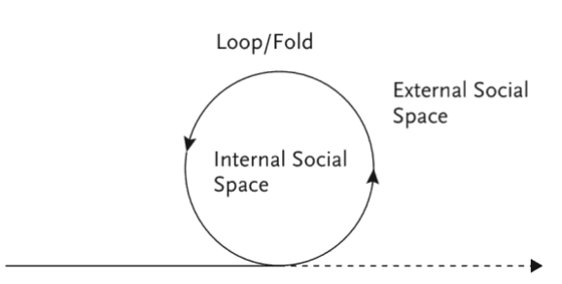
Contents
1. Mediation
2. Mediation in Meaning Changes
1.1. Semiotic mediation
1.2. Mediation & Language Education
2.1. The concept of “border”
2.2. The case of Vietnam-China border
✓Definition
✓Features
From barrier to connectivity
Forms
Movement of meaning
Human cognition
Development/
Acquisition

Slide 3
1.1.1. Linell’s (2009) Forms of Mediation
Perceptual
Practical
Linguistic & other Semiotic
Arterfact-based
reconstruct the world with language & other sign systems
modern technologies => knowledge and information that would be impossible to acquire and use merely with our bodies, senses or languages
our senses and bodies (limitations & potentials to perceive the world)
practical handling of objects in the world

Slide 4
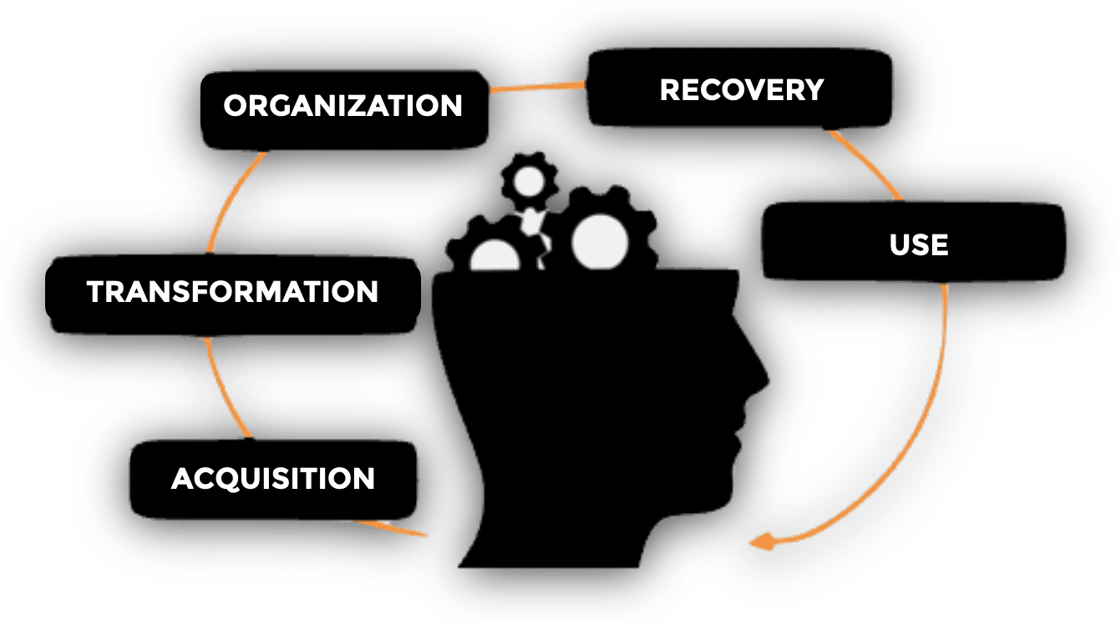
1.1.2. Mediation = movement of meaning
https://mbpschool.com/en/the-teaching-learning-process/
“Mediation involves the movement of meaning from one text to another, from one discourse to another, from one event to another. It involves the constant transformation of meanings …
<= media texts and texts about media circulate in writing, in speech and audiovisual forms, and
<= we, individually and collectively, directly and indirectly, contribute to their production”
(Silverstone, 1999, p. 13, quoted in Fairclough, 2013, p. 22)

Slide 5
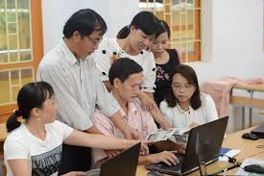
1.2.1. Mediation & Human cognition
Human cognition: inherently social - emerging out of participation in external forms of social interaction that become internalized psychological tools for thinking
(Vygotsky, 1978, 1986, cited in Valsiner, 2001)
Notes:
This transformation, from external (interpsychological) to internal (intrapsychological), is not direct, but mediated.

Slide 6
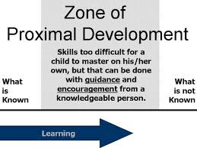
1.2.2. Mediation & Development/Acquisition
https://en.wikipedia.org/wiki/Zone_of_proximal_development
https://www.simplypsychology.org/zone-of-proximal-development.html

Slide 7
2.1. Traditional physical/conceptual borders
“us”
civilized
Friends
Close
Open
Foes
barbarian
“them”

Slide 8
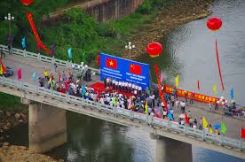
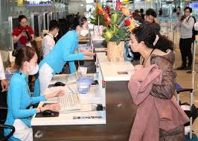
2.1. E.g. Spatial constructs in subjecting border regions and their concomitant touristic experiences
1
2
3
4
5
Bio-geographical space &
Local residents’ interpretation
Guides & 1 vs. several realities
Physical space of architectural forms
Social space: residents (hosts) - visitors (guests)
Visitors’ mental spaces

Slide 9
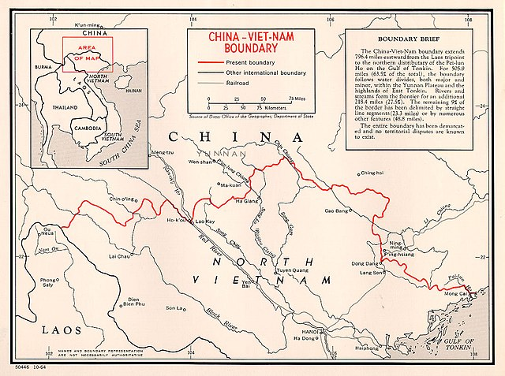
2.1.1. A border: Definition
Contrived physical spaces
Mental spaces
natural spaces
Political, strategic, social and psychological connotations of a border or barrier
Bio-geological location of the border (Sofield, 2006, p. 112)
Facilities to enable or control movements across the border
Notes:
a border is a combination of contrived physical spaces (the facilities that have been constructed to enable or control movements across the border) designed around quite specific mental spaces (the political, strategic, social and psychological connotations of a border or barrier) located in natural spaces (the bio-geological location of the border itself), with an ordering of practice that is controlled by instruments of the state in the exercise of its sovereignty. (Sofield, 2006, p. 112)

Slide 10
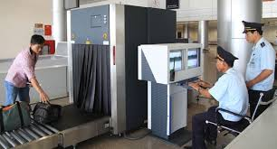
Perceived Space/Spatial Practice
The process of producing the material form of social spatiality, and thus presented as both a medium and outcome of human activity, behaviour and experience.
(Lefebvre, 1991, quoted in Sofield, 2006, p. 111)
Notes:
From an analytical standpoint, the spatial practice of a society is revealed through the deciphering of its space.

Slide 11
Conceived Space/ Representations of Space
Conceptualised space, the space of scientists, planners, technocrat subdividers, – all of whom identify what is lived and what is perceived with what is conceived.
also tied into the relations of production and to the order or design that they impose.
(Lefebvre 1991: 38–39, quoted in Sofield, 2006, pp. 111-112)
Notes:
Such order is constituted via control over knowledge, signs, and codes: over the means of deciphering spatial practice and hence over the production of spatial knowledge

Slide 12
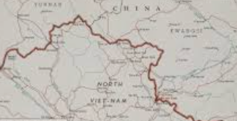
The Integratation of Mental & Material Borders
*GEOPOLITICAL BOUNDARIES: MATERIAL (NATURAL) – CONCEPTUAL-social & constitutional (material)

Slide 13
2.1.2. Features of a Border (Nail’s 2016)
In between
In motion
A process of circulation
Not reducible to space
a continually changing process: never done "including," s.o./s.th.
✓In between two spaces is not another space.
✓ Border defines society
“Between" states
A continuous division

Slide 14
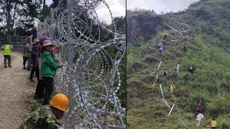
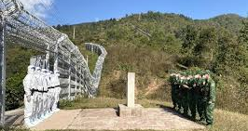
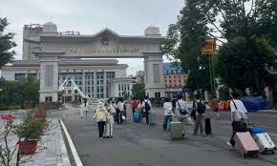
2.2. Vietnam-China Border: Barrier → Connectivity
1.
Fence
2.
“Wall”
3.
Checkpoint

Slide 15
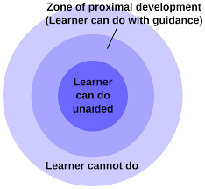
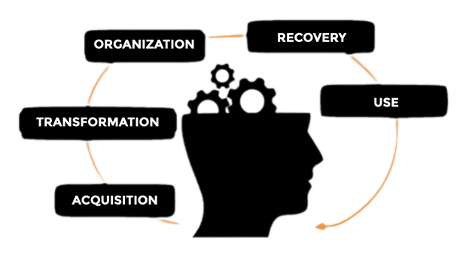
DISCUSSION: - Zone of proximal development & border; - Mediation = movement of meaning & Border: barrier - connectivity
1.
2.
3.
Notes:
Compare: Zone of proximal development vs. border

Slide 16
Conclusion
Arterfact-based mediation → technology in education
The integration of mental & teaching material & realia
Social interaction in language education

Slide 17
References
Fairclough, N. (2013). Semiosis, ideology and mediation A dialectical view. In I. Lassen, J. Strunck, & S. Vestergaard (Eds.). Mediating Ideology in Text and Image. John Benjamins Publishing Company. https://d1wqtxts1xzle7.cloudfront.net/32638550. Accessed on 19/8/2024.
Johnson, K. E. & Dellagnelo, A. K. (2013). How ‘sign meaning develops’: Strategic mediation in learning to teach. Language Teaching Research 17(4) 409 -432. https://d1wqtxts1xzle7.cloudfront.net/44739793. Accessed on 21/9/2024.
Linell, P. (2009). Rethinking language, mind, and world dialogically. Interactional and contextual theories of human sense-making. Charlotte, NC: Information Age Publishing.
Martsin, M. (2012). On mind, mediation and meaning-making. Culture & Psychology, 18(3), pp. 425-440. http://https://eprints.qut.edu.au/79013/1/82136.pdf. Accessed on 22/9/2024.

Slide 18
References
Nail, T. (2016). Theory of the Border. Oxford University Press.
Silverstone, R. (1999). Why Study the Media? Sage.
Valsiner, J. (2001). Process structure of semiotic mediation in human development. Human Development, 44(2/3), 84-97. https://lchc.ucsd.edu/mca/Mail/xmcamail.2006_10.dir/att-0296/01-Process_structure_Valsiner.pdf. Accessed on 20/9/2024.
Vygotsky, L.S. (1978). Mind in society. Cambridge, MA: Harvard University Press.
Vygotsky, L.S. (1986). Thought and language. Cambridge, MA: MIT Press.

Slide 19
Thank you
VNU-ULIS’ PROJECT N.24.12
trang123ulis@gmail.com​

