Slide 1
MEDIA LITERACY IN PRE-SERVICE EFL TEACHER EDUCATION: RELEVANCE AND CHALLENGES
Tran Thi Ngan
Hanoi Pedagogical University 2

Slide 2
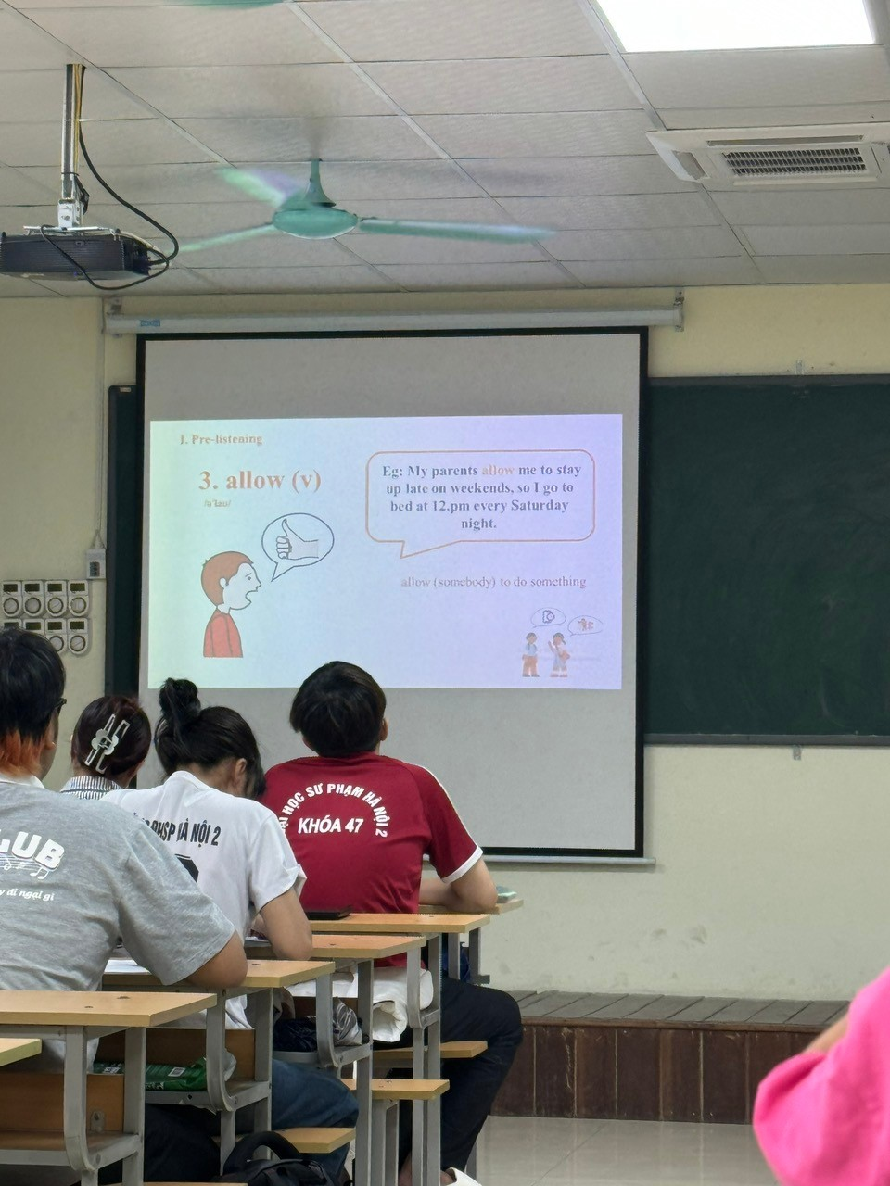
BACKGROUND
Pre-service EFL teachers
(Final year)
Courses:
Teaching Practice
Materials Development

Slide 3
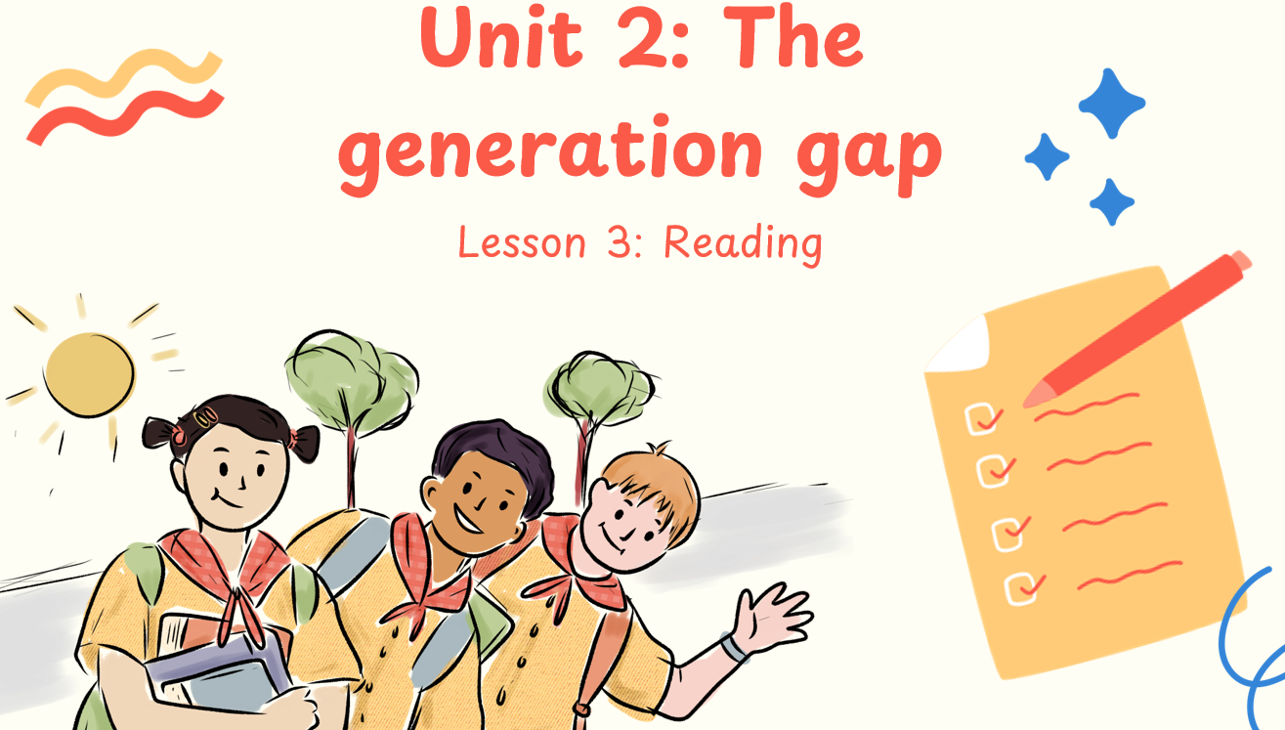
REFLECT ON MY OWN TEACHING PRACTICE

Slide 4
REFLECT ON MY OWN TEACHING PRACTICE

Slide 5
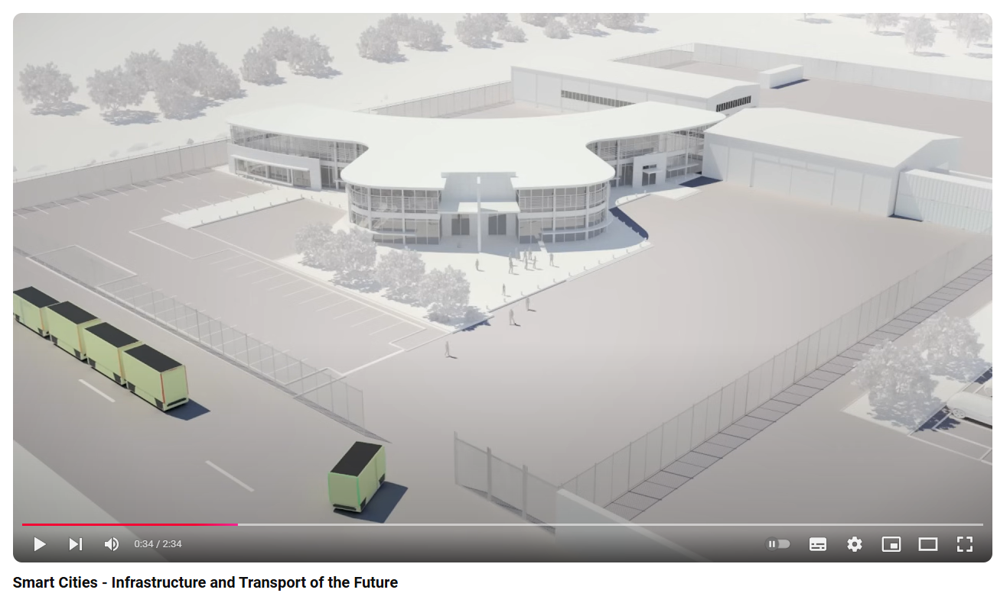
REFLECT ON MY OWN TEACHING PRACTICE
Cities of the future
Smart Cities - Infrastructure and Transport of the Future

Slide 6
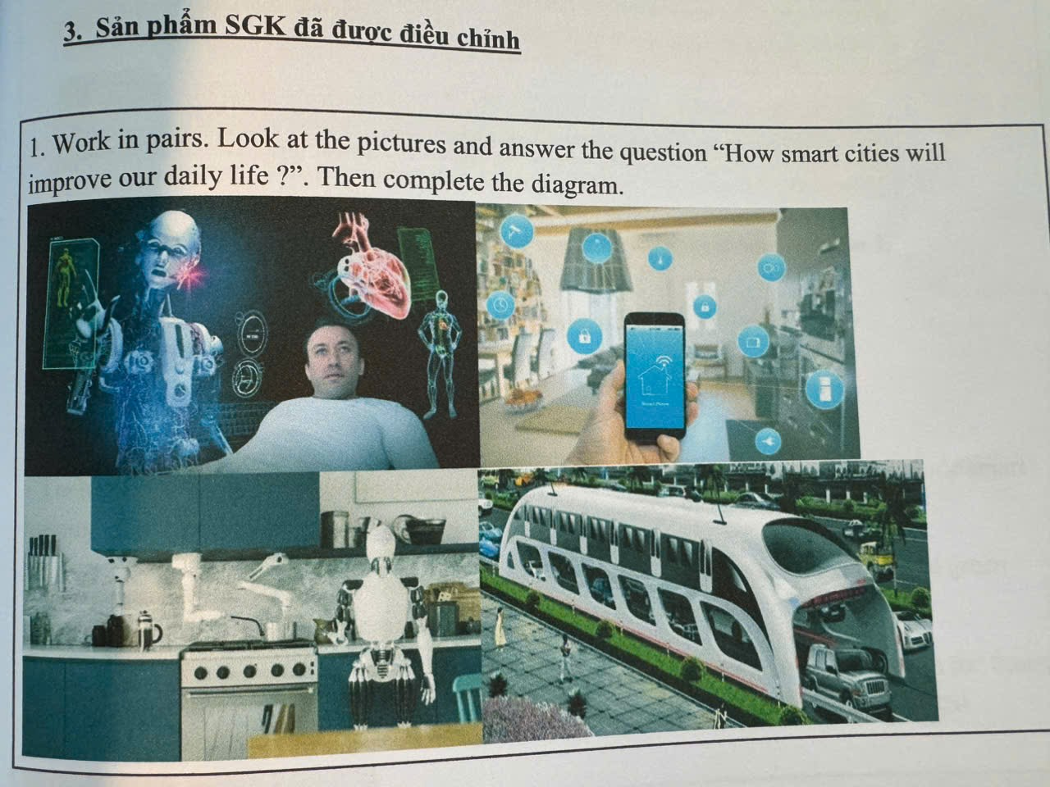
REFLECT ON MY OWN TEACHING PRACTICE

Slide 7
RATIONALE
Student seem to
Lack consciousness of media they include in their learning and practice
Pay little attention to the underlying elements/message in the media they employ
Pay little attention to the potential influence the media they use to their audience

Slide 8
REFLECT ON THE CURRICULUM
Media Literacy
No courses
No modules

Slide 9
THE INTEGRATION OF MEDIA LITERACY IN TEACHER EDUCATION PROGRAM

Slide 10
MEDIA LITERACY
Is the ability to access, analyze, evaluate, create, and effectively engage with different forms of media.
Involves understanding how media messages are constructed, the techniques used to influence audiences, and the underlying purposes or biases behind media content.

Slide 11
MEDIA LITERACY
Empowers individuals to critically interpret media, recognize misinformation, and produce content responsibly across various platforms, such as television, the internet, social media, and print.
Fosters informed and active participation in media consumption, promoting critical thinking, discernment, and ethical media use.

Slide 12
MEDIA LITERACY IN EFL TEACHER EDUCATION
Media literacy enables language teachers to use real-world media (e.g., news, films, podcasts) as authentic language-learning materials, exposing students to diverse accents, dialects, and colloquial expressions. (Kaiser, 2011)

Slide 13
MEDIA LITERACY IN EFL TEACHER EDUCATION
Language teachers trained in media literacy can teach students to critically analyze how language is used in the media, such as identifying bias, persuasion techniques, and the power of word choice in shaping opinions. Studies show that fostering critical language awareness enables students to deconstruct media texts, improving their overall language competence and critical thinking (Rivers, 2018)

Slide 14
MEDIA LITERACY IN EFL TEACHER EDUCATION
Media literacy enables language teachers to teach students how to interpret and create multimodal texts, moving beyond traditional reading and writing to include visual literacy, speech, and digital media production. This prepares students for modern communication demands (Serafini, 2014) .

Slide 15
MEDIA LITERACY IN EFL TEACHER EDUCATION
Media literacy in language education allows students to engage with authentic media from different countries, fostering cultural awareness and reducing ethnocentrism (Thorne, 2016).
Notes:
This approach is particularly important in second language learning, where understanding the cultural context is key to language proficiency

Slide 16
MEDIA LITERACY IN EFL TEACHER EDUCATION
Using media literacy strategies, language teachers can leverage modern, relatable media content—such as YouTube videos, social media, and online articles—to make language learning more engaging and relevant. Contemporary content resonates with students, improving motivation and engagement in the learning process (Kabilan et al., 2010)

Slide 17
MEDIA LITERACY IN EFL TEACHER EDUCATION
Media literacy prepares language teachers to teach students language skills that are essential for navigating digital media, such as writing concisely for social media, interpreting online news, and understanding how language is used in online communication. These skills are crucial in today's media-driven world (Lankshear & Knobel, 2011) .

Slide 18
MEDIA LITERACY IN EFL TEACHER EDUCATION
Media literacy encourages critical thinking by teaching students to question and analyze media texts in a target language. This builds deeper cognitive skills and encourages students to move beyond surface-level language comprehension. According to Warschauer (2010), incorporating media literacy in language education fosters critical engagement with texts, which is key to advanced language learning

Slide 19
MEDIA LITERACY IN EFL TEACHER EDUCATION
Media literacy allows language teachers to explore how media perpetuates stereotypes or language ideologies, such as the portrayal of certain accents or dialects as inferior. Teachers can guide students in recognizing and challenging these ideologies, helping students form more inclusive views of language diversity (Pennycook, 2012)

Slide 20
MEDIA LITERACY IN EFL TEACHER EDUCATION
Media literacy fosters lifelong learning by equipping students with the ability to critically analyze and adapt to evolving media environments. This is essential for language learners, who must continuously adapt to new media platforms, linguistic trends, and communication tools (Gee, 2004) .

Slide 21
MEDIA LITERACY IN EFL TEACHER EDUCATION
By integrating media literacy into language teacher education, educators can equip future generations with the skills to navigate and critically engage with the media-rich world while developing strong linguistic and intercultural competencies.

Slide 22
THE STUDY

Slide 23
PARTICIPANTS
150 Pre-service EFL teachers – HPU2
Upper-Intermediate level in English
Related courses:
Technology in English Language Teaching and Learning
Teaching Practice Course (1st semester – 3rd year)
Teaching Practicum (05 weeks at high school – 2nd semester – 3rd year)
Materials Development (1st semester – Final year)
Teaching Practice Course (1st semester – 4th year)
Teaching Practicum (07 weeks at high school – 2nd semester – 4th year)

Slide 24
PARTICIPANTS
Technology in English Language Teaching and Learning
Teaching Practice Course (1st semester – 3rd year)
Teaching Practicum (05 weeks at high school – 2nd semester – 3rd year)
Materials Development (1st semester – Final year)
Teaching Practice Course (1st semester – 4th year)
Teaching Practicum (07 weeks at high school – 2nd semester – 4th year)
Training program is developed, reviewed, and updated annually with reference to those of some domestic and foreign education institutions.

Slide 25
INSTRUMENTS
Questionnaire: Media Literacy Level Determination Scale (MLLDS)
Interview

Slide 26
PARTICIPANTS’ LEVEL OF MEDIA LITERACY

Slide 27
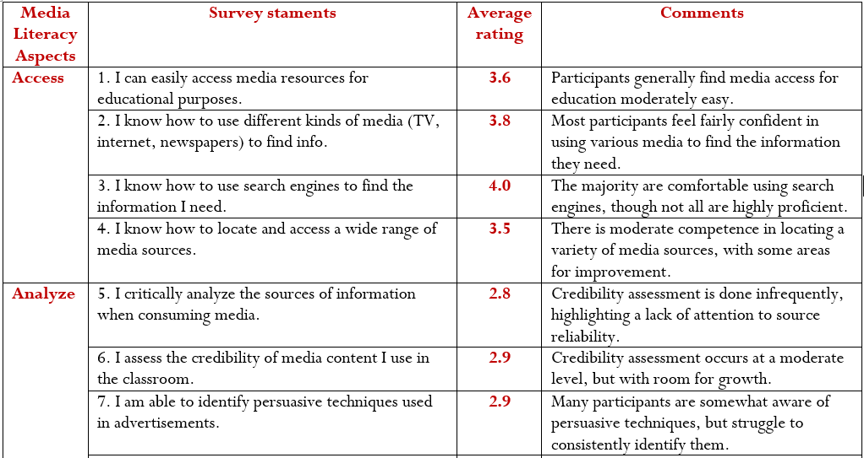

Slide 28
KEY INSIGHTS
Access & Analyze: Participants demonstrate difficulty accessing a wide range of media resources and lack strong critical analysis skills when consuming media. The low scores reflect challenges in engaging with media beyond basic functions.

Slide 29
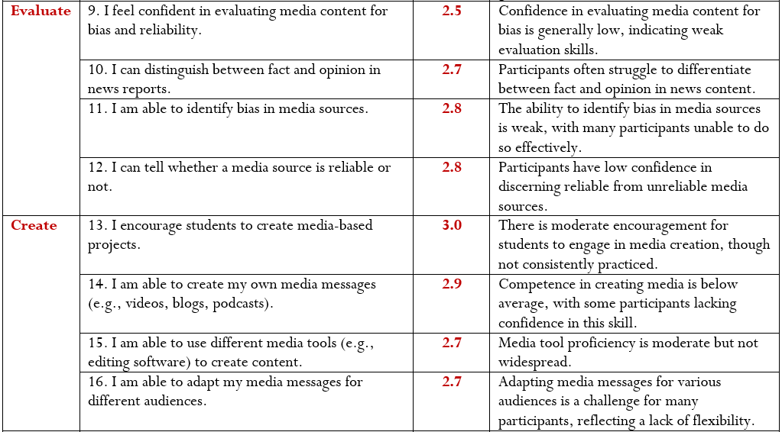

Slide 30
KEY INSIGHTS
Evaluate: There is limited confidence in evaluating media content for bias, reliability, and distinguishing between fact and opinion. This highlights the need for improved media evaluation skills.
Create: Media creation skills are underdeveloped, with low proficiency in creating media messages or using media tools effectively.

Slide 31
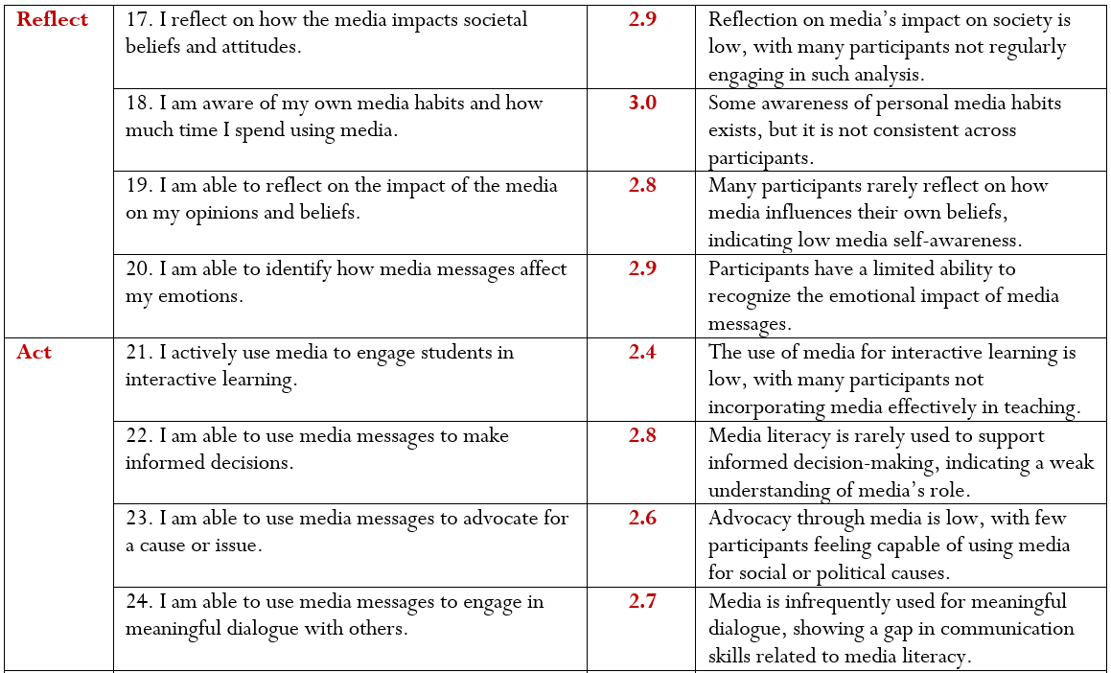

Slide 32
KEY INSIGHTS
Reflect & Act: Reflection on the impact of media and active engagement through media is minimal. Participants do not often use media to make informed decisions or engage in interactive learning, advocacy, or dialogue.

Slide 33
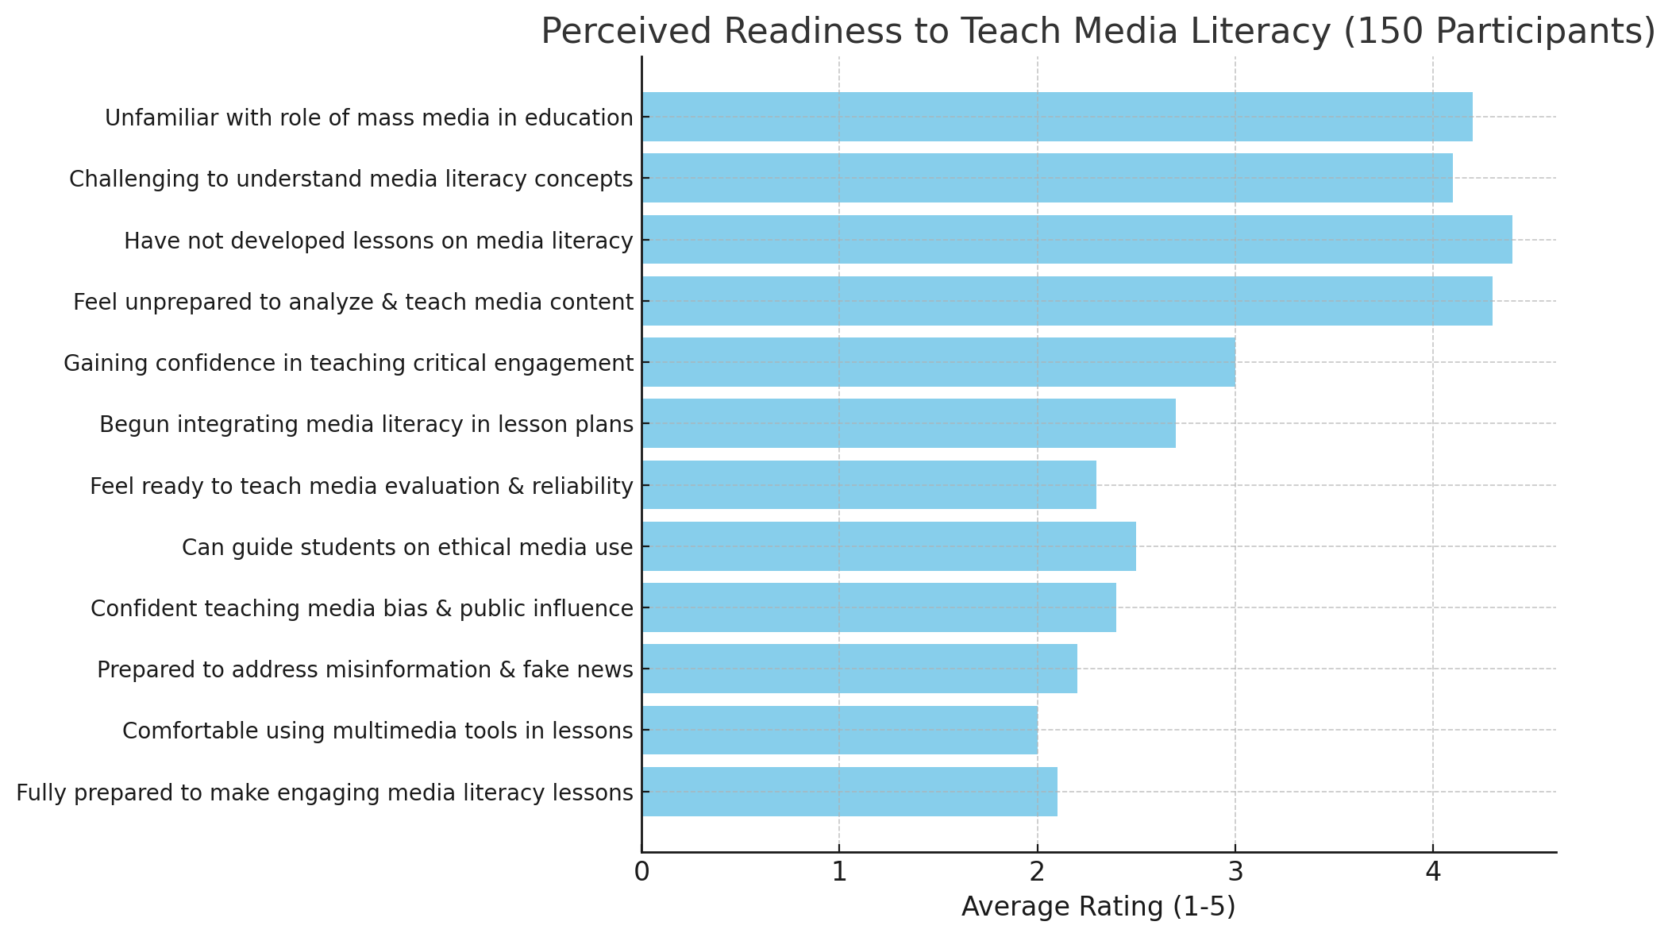

Slide 34
The results suggest that participants feel generally unprepared, with higher ratings indicating challenges in understanding media literacy concepts and a lack of lesson development. Ratings for skills such as using multimedia tools and addressing misinformation are notably lower, reflecting a lack of confidence in these areas.

