Slide 1
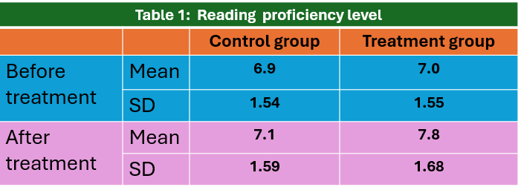
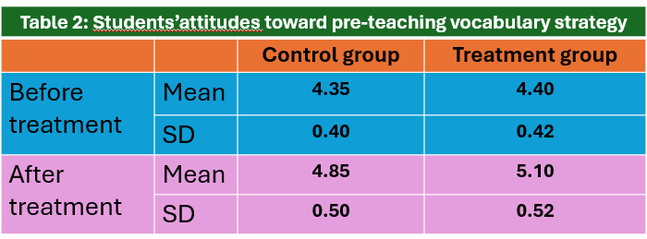
VINHTESOL 2024
25-26 October 2024
Vinh, Nghe An, Vietnam
Logo đơn vị công tác của tác giả chính
Using pre-teaching vocabulary strategy to improve reading comprehension skills for English major students.
^{Nguyễn Thị Hiền Lương}
Department of Foreign Languages
Vinh University, Vietnam
Introduction
Results
Reading plays an important role in learning a foreign language
The reading proficiency level of English major students was quite low.
The need to apply pre-teaching vocabulary strategy to improve reading comprehension skills for English major students.
Methodology and Participants
Two groups
Three months
Qualitative and quantitative
Two tests
Research questions
1. How does the vocabulary pre-teaching strategy affect the reading comprehension skills of English major students over the course of three months?
2. How do students perceive the vocabulary pre-teaching strategy in terms of its impact on their reading problems and overall learning experience?
Implications
1. Incorporating pre- teaching vocabulary strategy into the curriculum could be essential for improving reading comprehension skills among English major students.
2. Integrating vocabulary pre-teaching as a core component of reading courses involving creating specific modules focused on vocabulary enhancement to support reading comprehension.
*Contact: Nguyễn Thị Hiền Lương, Vinh University. Address: 182 Le Duan Street, Vinh city, Nghe An, Vietnam. Email: Hienluongdhv79@gmail.com. Cellphone: +84 912480100

