Slide 1
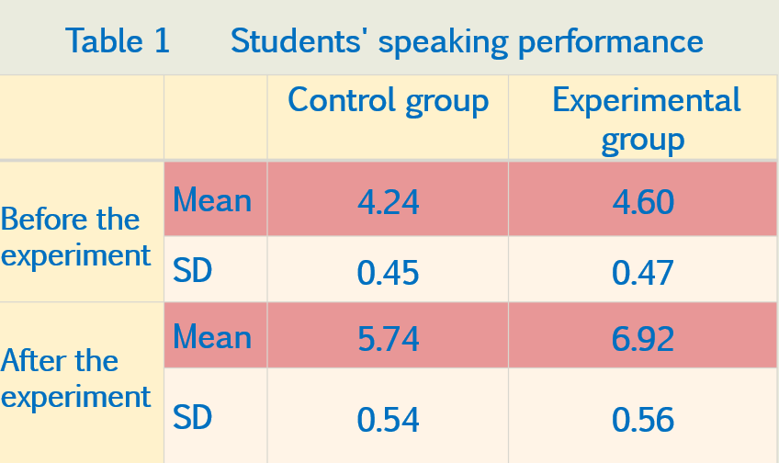
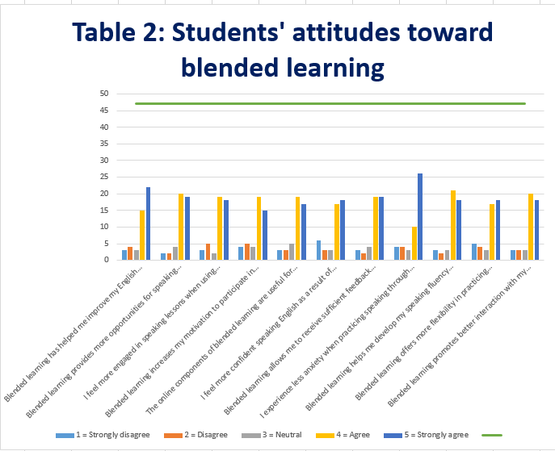
VINHTESOL INTERNATIONAL CONFERENCE 2024
25th, 26th October 2024
Vinh, Nghệ An, Vietnam
Blended Learning - An Alternative Way
to Conduct Speaking Lessons to EFL First-Year Students
Trần Thị Vân Anh, Vinh University.
Introduction
Results
Aims:
- To investigate first-year EFL students’ perceptions of using blended learning to improve their speaking skills
- To examine the effectiveness of blended learning in enhancing speaking performance through a structured experiment
Research questions:
1. How does the use of blended learning impact the speaking performance of first-year EFL students?
2. What are the perceptions of first-year EFL students toward the use of blended learning for speaking skill practice?
Methodology and Participants
- 2 groups of first-year non- English majored students
- 13 weeks
- a pre-test, a post test and a questionnaire
Discussions
- Most of students in the experimental group improved speaking performance compared to the control group
- The combination of online and face-to-face learning environments enhanced opportunities for practicing speaking skills
- Most of students in the experimental group expressed positive attitudes toward blended learning
- One key finding is the increased motivation among students in the blended learning group
- Some students may experience less anxiety in a blended learning environment
- Blended learning provided the flexibility in teaching and learning and the accessibility to different resources
Implications
Educators should explore ways to incorporate blended learning into their curricula, with an emphasis on the balanced integration of technology and face-to-face interactions.
Long-term impacts, student preferences for specific blended learning tools, and the adaptability of this approach in different cultural or institutional contexts could be investigated in the future
Contact
Conclusion
Trần Thị Vân Anh, Vinh University.
Address: 182 Le Duan Street, Vinh city, Nghe An, Vietnam.
Email: manhcuongthuyhang@gmail.com
Cellphone: +84 902187097
- Blended learning presents a viable and effective alternative for conducting speaking lessons to EFL learners.
- With the right implementation, blended learning has the potential to transform language teaching in the digital age.

