Slide 1


Code-Switching in EMI Classrooms in Vietnam: A Preliminary Case Study
Nguyen Quang Tien
(Ho Chi Minh City University of Industry and Trade – HUIT)
Vu Thi Phuong Anh
(Hong Bang International University – HIU)

Slide 2
Introduction
EMI (English-medium instruction) classes - offered in Vietnam
Code-switching in General English (GE) and English for Specific Purposes (ESP) classes and in English-medium Instruction (EMI) classes
A preliminary narrative case study on the CS practice in Maths classes at an international private school in South Vietnam

Slide 3
English-Medium Instruction (EMI)
“The use of the English language to teach academic subjects in countries or jurisdictions where the first language of the majority of the population is not English”
(Macaro et al., 2017, p. 37)

Slide 4
English-Medium Instruction (EMI)
The main goal of EMI
Delivery of academic content in English or content mastery
Very little or no explicit focus on language proficiency enhancement (that is, teachers are not expected to teach the language explicitly)

Slide 5
English-Medium Instruction (EMI)
EMI Students
EMI - increasingly applied in international programs in universities, secondary school, and even primary schools in non - English speaking countries where students may not be native English speakers (Dearden, 2015).
Assumed to have reached a certain level of English proficiency

Slide 6
English-Medium Instruction (EMI)
EMI Courses
All interactions in English
(between teachers and students or between students and students)
Course materials in English
Learning the content of a subject and improving English proficiency
(Rose & Galloway, 2019)

Slide 7
English-Medium Instruction (EMI)
EMI & Code-Switching
Though forbidden or discouraged to use the students’ first language in English classes, many teachers in the case studies still “code switched to a greater or lesser extent and for a variety of reasons.”
Whether local lecturers use a variety of English, including British or American English, it is likely that their spoken, and perhaps written production, will be influenced by their first language (Barnard, 2018, p.10)

Slide 8
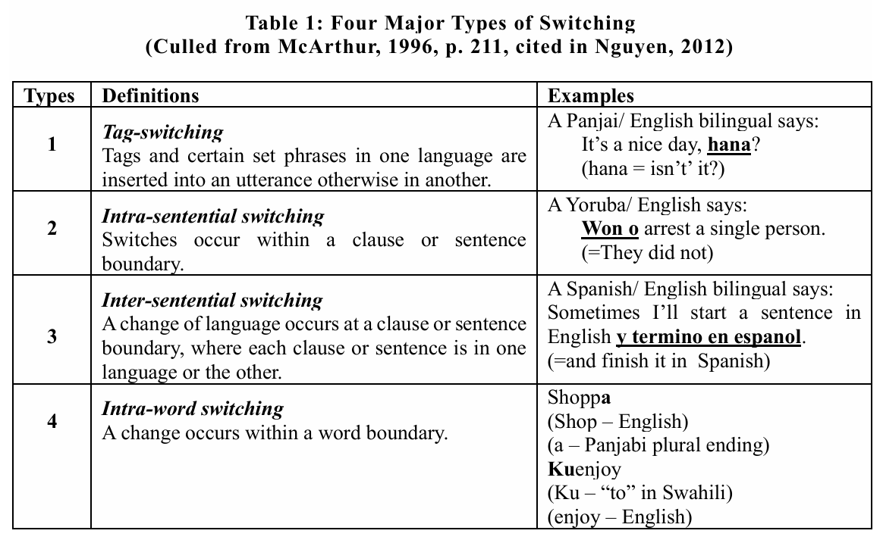
Code switching in English language teaching

Slide 9
The Preliminary Case Study
Research design: Descriptive (Narrative & Reflective)
Participant: One Vietnamese teacher of Maths
Teaching experience: + MBA, ten years of teaching experience, almost three years of experience of teaching Maths in English in EMI classes + A content teacher, not a language teacher
Research venue: A private international high school, South VN
Research conducted: 2023
Data collection: Two in-depth personal interviews
Research question:
“What factors (situational and sociolinguistic) contribute to the teacher’s code-switching practice in EMI classes?”

Slide 10
The Preliminary Case Study
Context
EMI programs (like Maths, Science, Wellbeing) in English – in tandem with the national curriculum in Vietnamese
Vietnamese teachers are now recruited to teach Maths in English because of two reasons:
(1) they clearly know whether the knowledge being taught in English is quite new to students and whether it has previously been taught to students in Vietnamese; and
(2) they can use Vietnamese as an aid in teaching Maths to students, particularly those with low English proficiency.

Slide 11
The Preliminary Case Study
Findings
Intra-sentential CS happens in the teacher’s Maths classes.
The school, teacher, and parents have positive attitudes.
* CS can happen in translanguaging.

Slide 12
The Preliminary Case Study
Findings
“What factors (situational and sociolinguistic) contribute to the teacher’s code-switching practice in EMI classes?”
Reasons/ Factors for the CS practice
The discrepancies in the Maths curriculums in Vietnamese and in English;
The prioritized goals of teaching Maths;
The students’ limited knowledge of subject matter (e.g., Maths);
The institution’s support for CS (implicit or explicit); and
The teacher’s decision to personally sacrifice her own benefits

Slide 13
Limitations, Implications and Recommendations
Limitations
Sampling
(limited to only one voluntary teacher participant);
Data collection
(limited to only two personal in-depth interviews with the participant)

Slide 14
Limitations, Implications and Recommendations
Implications
EMI programs should merge with the national curriculum.
Comprehensible input
→ gradually withdraw CS (seen as a scaffold) at a certain future point

Slide 15
Limitations, Implications and Recommendations
Recommedations
(1) Larger scale studies (with various sources of data)
(2) Further studies on other aspects of EMI classes

Slide 16
Conclusion
Though it is not a formal feature of EMI, CS can be one of the opportunistic, helpful aids or strategies in students’ comprehension of the subject matter in EMI classes.
The main purposes of CS in EMI classes found in the study are:
(1) to clarify difficult concepts;
(2) to maintain the classroom flow; and
(3) to bridge the language gaps

Slide 17
References
Barnard, R. (2018). Setting the scene: EMI in Asian university. In Roger, B., & Zuwati, H. (Eds), English medium instruction programs: Perspectives from South East Asian universities, p.1- 14. New York: Routledge.
Dearden, J. (2015). English as a medium of instruction – A growing global phenomenon. British Council: https://ora.ox.ac.uk/objects/uuid:4f72cdf8-b2eb-4d41-a785-4a283bf6caaa
McArthur, T. (1996). The concise Oxford companion to the English language. Oxford: Oxford University Press.
Macaro, E., Curle, S., Pun, J., An, J., & Dearden, J. (2017). A systematic review of English medium instruction in higher education. Language Teaching, 51(1), 36–76.
Nguyen, Q. T. (2012). English-Vietnamese code-switching in tertiary educational context in Vietnam. Asian Englishes, 15(2), 4-29.
Rose, H., & Galloway, N. (2019). Global Englishes for Language Teaching. Cambridge: Cambridge University Press.

Slide 18


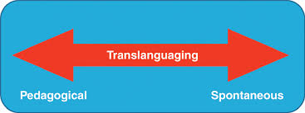
Thank you for listening!

