Slide 1
VinhTESOL 2024 preliminary conference
Utilizing Extensive Reading
To Enhance Reading Motivation
Among EFL High School Students
Presenters: Nguyễn Thị Kim Anh & Nguyễn Thị Trang Nhung

Slide 2
Table of contents
01
02
03
04
05
06
Introduction
Background
Methodology
Implications
Findings & Discussion
Limitations & Suggestions

Slide 3
Rationale
01
Introduction
In FL education, reading is indispensable to vocabulary acquisition, grammar comprehension and the development of overall language proficiency.
2 distinct approaches to reading: INTENSIVE READING & EXTENSIVE READING
Test-oriented???
Teacher-centered???
EXPECTATION
Language education
=
Intensive Reading
+
Extensive Reading
REALITY
Language education
=
Intensive Reading

Slide 4
Benefits of Extensive Reading
- Improve learners’ pleasure & motivation
- Develop good reading habits, increase reading speed and comprehension rate
- Boost language proficiency
- Enhance learner autonomy

Slide 5
Vietnam
- Frequent exposure to intensive reading (at educational institutions)
- Concerted effort in extensive reading implementation over the past few years, mostly at universities, NOT high school.
Prove effective, yet challenging (lack of reading materials, limited time, policy and financial constraints, etc.)
English-majored students: lack of reading motivation → NEED FOR CHANGE
fairly high autonomy
willingness to comply with teacher’s demand

Slide 6
Goals & Objectives
Investigate the potential of ER (online) to enhance EFL high school students’ reading motivation
Foster a more positive attitude towards reading by increasing time quantity devoted to pleasure reading outside classroom

Slide 7
Scope
Class 11A7 - 41 English-majored students, High School for the Gifted, Vinh University
2 months (April-May) – 2nd semester - School year 2023-2024
Online ER via ER-central website
Research Questions
To what extent does extensive reading influence EFL high school students’ reading motivation?
What are the students’ perceptions towards extensive reading?
Notes:
Narrow scope → greater feasibility and more focused investigation but limited generalizability, lack of external validity (the findings may not apply to a wider population or different contexts such as ER via offline sources or ER via other online platforms)

Slide 8
Background
02
2.1. EXTENSIVE READING
Definition:
Key points: Reading great quantities of materials (often self-selected) of various topics with an emphasis on overall understanding.
Controversial points:
Materials should be within or beyond students’ levels.
ER is necessarily pleasurable or not.
ER is not only an approach to reading but also AN EDUCATIONAL PEDAGOGY.
Characteristics:
often illustrated in 10 principles proposed by Day and Bamford (1998)
ER in application needs careful consideration → Pure ER, Modified ER, Light ER, Fringe ER
Notes:
All agree that ER is a method of/ an approach to reading that allows access to great quantities of self-selected materials so that readers can understand the texts generally. Meanwhile, it is still argued whether the materials should be within or beyond students’ level and whether ER should be pleasurable or not.

Slide 9
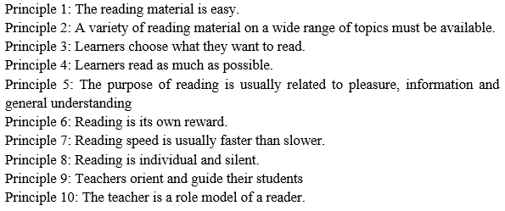
10 principles of teaching ER (Day & Bamford, 1998)

Slide 10
ER contributes to improvements in both linguistic and non-linguistic aspects
ER hasn’t been widely adopted due to numerous practical challenges
(time/ finance constraints, lack of suitable materials, lack of motivation, insufficient support and training, etc.)
ER in Vietnam: occasional and unsystematic implementation
Reason: exam-oriented learning culture and educational policy
teachers’ unequal awareness of ER
lack of time/ funding/ training
- Online ER: proven advantages (access to many engaging authentic materials, immediacy, convenience, etc.) → increased popularity over the past few years.

Slide 11
Background
02
2.2. READING MOTIVATION
Definition:
“the individual’s personal goals, values, and beliefs with regard to the topics, processes, and outcomes of reading” (Wigfield & Guthrie, 2000)
Reading motivation determines reading proficiency, academic and cognitive achievements.
Characteristics: complex (multidimensional) & dynamic (changeable)
Complex: 2 widely used models of reading motivation
L1 reading motivation model by Guthrie and Wigfield
L2 reading motivation model by Day and Bamford
Notes:
Personal goals: This refers to what a reader hopes to achieve through reading. It could involve gaining knowledge in a specific subject, improving reading comprehension skills, or simply enjoying a good story.
Values: This relates to the reader's beliefs about the importance and worth of reading. Someone who values reading might see it as a way to learn new things, expand their worldview, or relax and unwind.
Beliefs: This refers to the reader's convictions about themselves as readers and about reading in general. For instance, a student might believe they are a good reader and that reading is an enjoyable activity.
This definition highlights that a person's motivation to read is driven by a complex interplay of their individual goals, values, and beliefs surrounding reading.

Slide 12
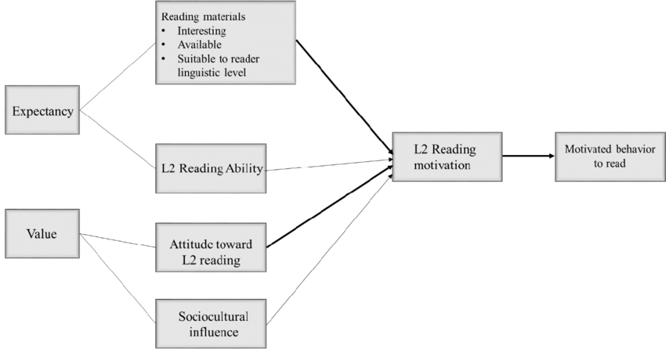
Models of reading motivation
Guthrie and Wigfield’s model
of L1 reading motivation
Day and Bamford’s model
of L2 reading motivation
I. Competence & Reading Efficacy | 1. Reading efficacy 2. Reading challenge 3. Reading work avoidance
II. Achievement Value & Goals | Intrinsic motivation 4. Reading curiosity 5. Reading involvement 6. Importance of reading Extrinsic motivation 7. Competition in reading 8. Reading recognition 9. Reading for grades
III. Social Aspects of Reading | 10. Social reasons for reading 11. Reading compliance

Slide 13
2.3 PREVIOUS STUDIES ON ER AND READING MOTIVATION
Many studies have been conducted in Asian nations like Japan, Malaysia, Indonesia, displaying positive correlational relationship between ER and reading motivation. In Vietnam, despite limited literature, the same findings can be generated.
However, these studies show no consistent model for reading motivation measurement (as this subject matter is context-dependent) and the findings seem varied.
➔ The researcher decided to rely on the only model available for L2 reading motivation research by Day and Bamford, but at the same time considering the findings of other experts on motivation in general in data analysis.

Slide 14
Methodology
03
Action research: Qualitative + quantitative method
3.1 Participants – Settings
Participants: 41 11th-grade English-majored students at High School for the Gifted – Vinh University (class 11A7) (Convenience sampling)
Language proficiency: B1-C1 (CEFR); 6 English lessons/ week; fairly high learner autonomy, hectic schedule, and a passion for electronics
Settings: Over 8 weeks, students read extensively on the website www.er-central.com
(founded by Dr. Rob Waring, an acknowledged expert in ER)
Students’ project participation is voluntary and has no effect on course assessment

Slide 15
Questionnaires
1 pre-treatment & 1 post-treatment
Weekly Journals
Freestyle, informal
Reflect on reading texts + reading experience
Observation Notes
Notes on students’ participation in class discussions, interactions with peers and teacher.
Both close-ended and open-ended questions
3.2 Instruments
Triangulation: Questionnaires, Students’ weekly journals, teacher’s observation notes
Instruments for data collection

Slide 16
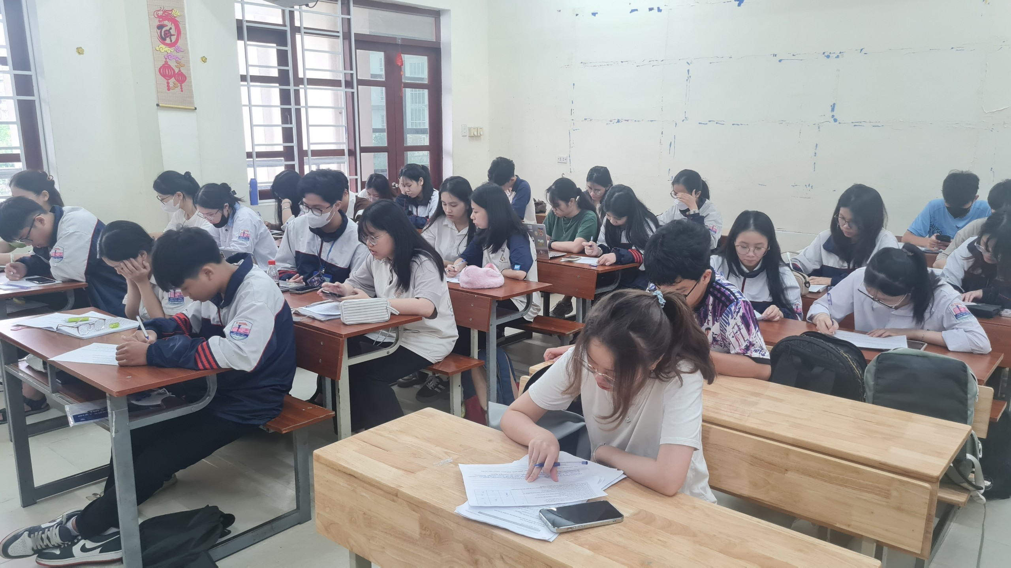
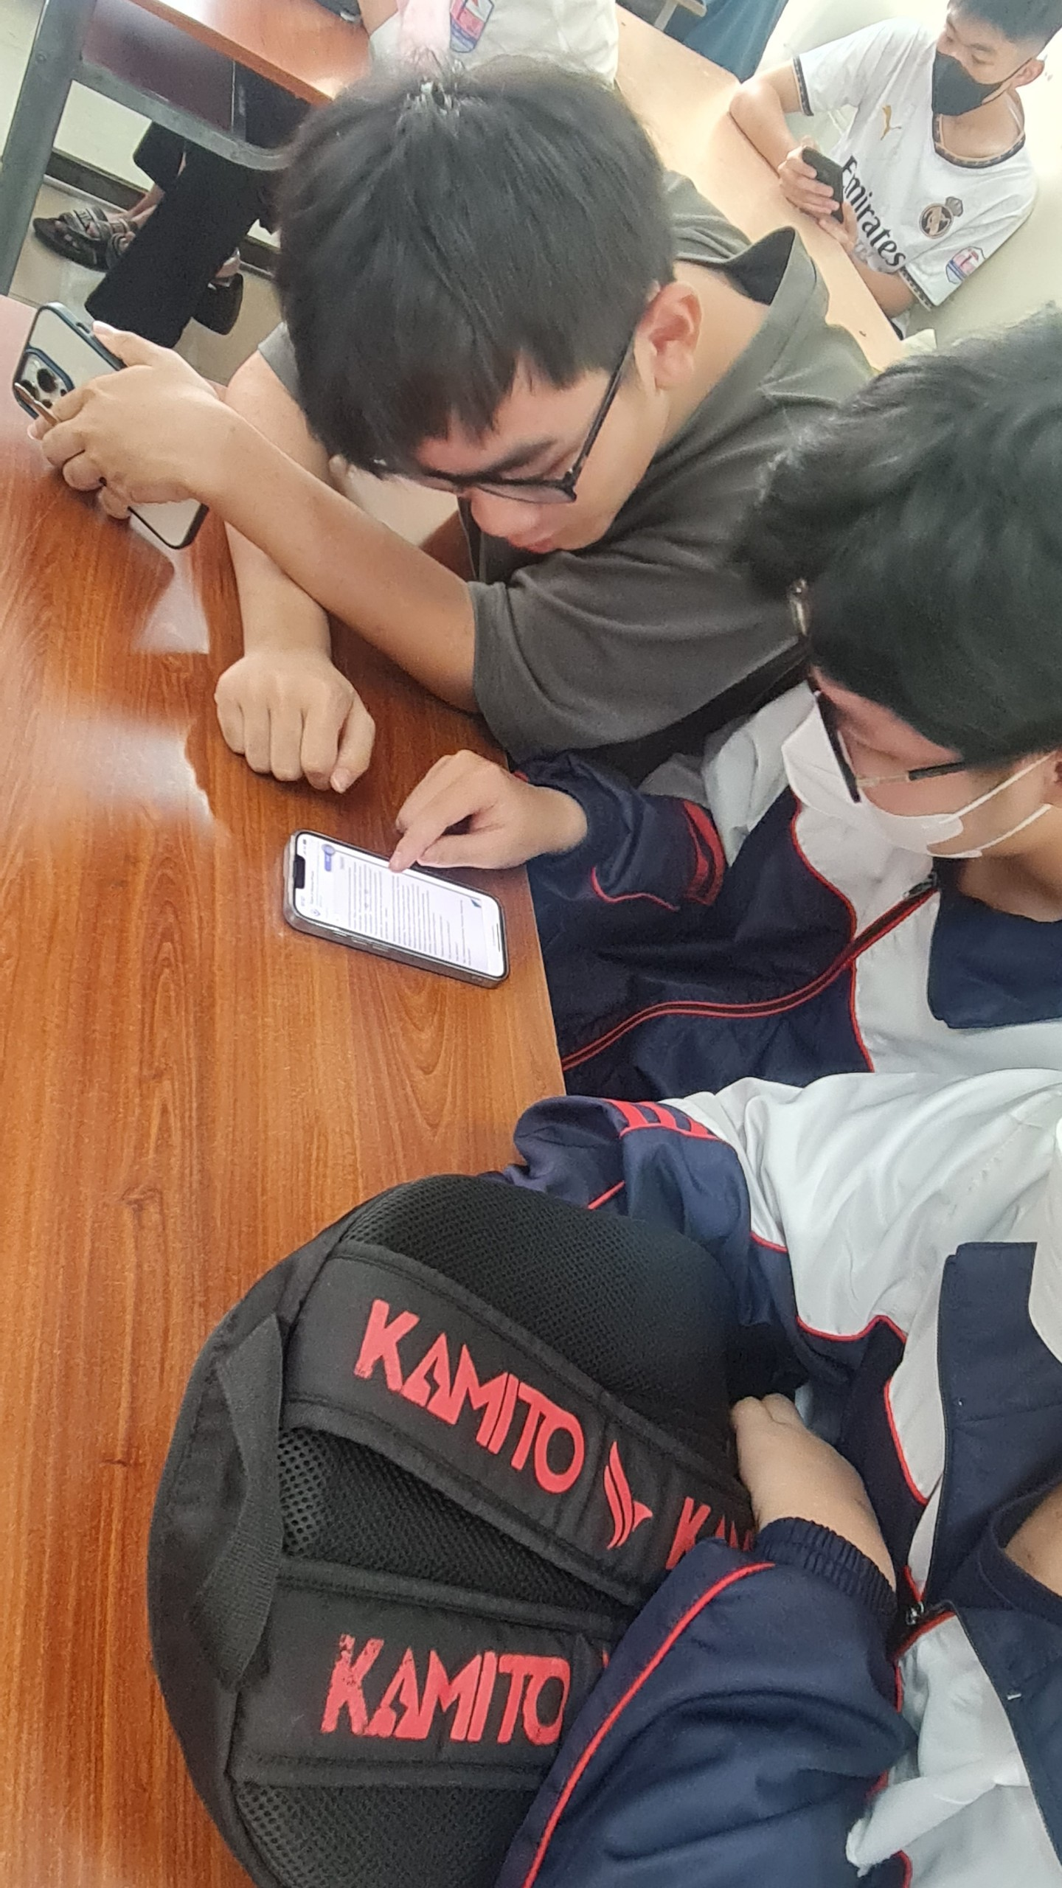
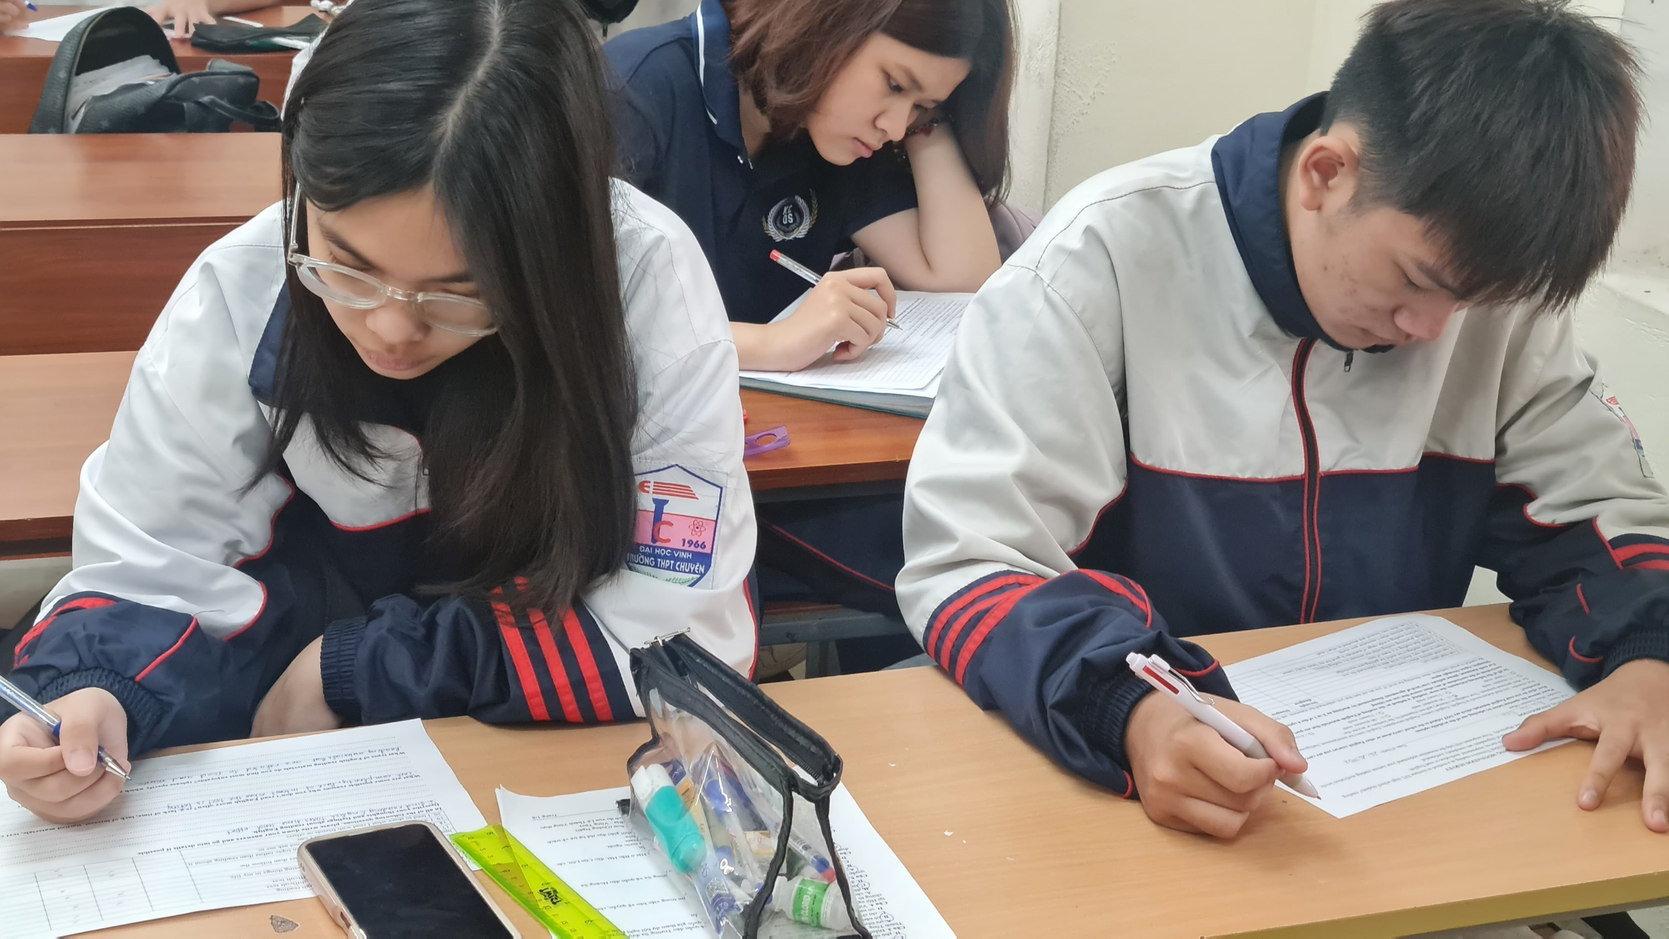
3.3 Procedures
1
2
3
5
6
4
Material selection
Pre-treatment
questionnaire
Introductory
session
8-week ER
Post-treatment
questionnaire
Data analysis
Descriptive statistical analysis
Thematic analysis
Findings & Conclusions
7

Slide 17
Findings & Discussion
04

Slide 18
Online ER exerted positive impacts on EFL high school students’ reading motivation, across all 4 variables
Question 1

Slide 19
Online ER’s influence | Examples
Students built up intrinsic motivation , more positive attitudes towards L2 reading | + students realized multiple importances of reading (for knowledge, pleasure, language development and habit development). + students became more enthusiastic about reading if given the free choice of materials
More profound changes were recorded in L2 reading ability & socio-cultural influence: | + L2 reading ability: students became more self-confident in reading ability and more fluent + Socio-cultural influence: students took a more active role in reading and a reading community has been unconsciously established
Students’ problems in selecting materials outside classroom were addressed | + students could access a wide range of engaging comprehensible texts at their levels + materials were available anytime anywhere for free
Notes:
at the beginning, sts think reading Eng is mostly for grade improvement, some mention knowledge acquisition or language development. Towards the end, many more state so, and claim it should be pleasurable.

Slide 20
Students’ perception of online ER
- Most formed a favorable attitude. They enjoyed the reading materials provided, felt more confident in reading and pleased with the comprehension tasks becoming optional.
- Online ER helped them improve vocabulary and made them realise the significance of regular non-academic reading
- MOST students were willing to read extensively online in the future
FEW students showed conditional interest as they need more time or
paper-based/ academic materials.
Question 2

Slide 21
Students’ perceptions of online ER’s strengths and weaknesses
Strengths
Accessibility
Potential values
Weaknesses
Technical errors
Unattractive design
Material diversity
Engaging and useful contents
Lack of customization for mobile devices
ER-Central website: short texts, some lack coherence & cohesion
Question 2

Slide 22
Implications
05
Theoretical implications
A testament to theories: reading motivation is complex & dynamic; ER use is situation-specific
Practical implications
Further ER implementation in teaching practice
Enrichment of literature concerning the correlation between ER and reading motivation
Insightful guidance on ER use at high school for EFL gifted students: high-quality source of materials; introduction of printed materials and more ER activities into classroom; data collection about the students’ interests and preferences

Slide 23
Limitations & Suggestions
06
Small population size (41), short time (2 months) → unrepresentative findings
Suggestion: Further research should be conducted on a larger scale & over a longer duration
Elements of speculation and subjectivity
➔ Suggestion: The researcher should collaborate with/ ask for consultation from some experts in reading and psychology

Slide 24
Thanks!
Do you have any questions?

